Slide 1
Part II
Electricity and Magnetism
Concept of Charge and Coulomb’s Law
Electric Fields
Gauss’ Law
Electric potential
Capacitance
Current and Resistance
Circuit
Magnetic Fields

Slide 2
Part II
Heat and Thermodynamics
Thermometry
Heat
Kinetic Theory of Gas
Equation of State

Slide 3
First Law of Thermodynamics
Second Law of Thermodynamics
Thermodynamics
Entropy
Thermodynamic Functions
Maxwell’s Reations

Slide 4
Lecture on Electricity: Coulomb’s Law
Prof. Dr. Md. Abu Saklayen
United International University
Reference Books: 1. Fundamentals of Physics-
By Halliday-Resnick-Walker (10th edition)
2. Physics for Engineers (Par-II)-By Dr. Giasuddin Ahmed

Slide 5
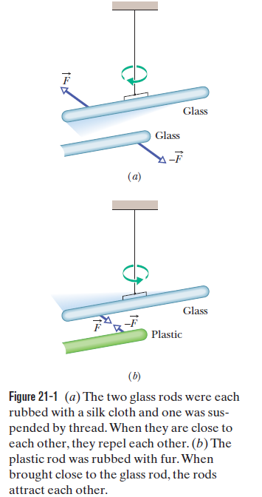
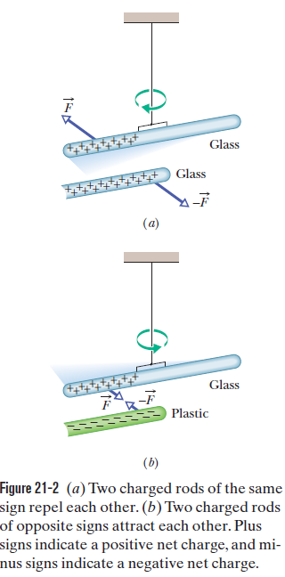
Concept of charge

Slide 6
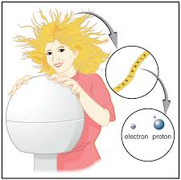
Introduction Continued
What is charge?
How do we visualize it.
What is the model.
We only know charge exists because in experiments electric forces cause
objects to move.
Electrostatics: study of electricity when the charges are not in
motion. Good place to start studying E&M because there are
lots of demonstrations.

Slide 7
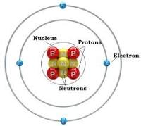
Some preliminaries
Electron: Considered a point object with radius less than 10⁻¹⁸ meters with electric charge e= -1.6 x 10 ⁻¹⁹ Coulombs (SI units) and mass m_{e}= 9.11 x 10 ⁻ ³¹ kg
Proton: It has a finite size with charge +e, mass m_{p}= 1.67 x 10⁻²⁷ kg and with radius
0.805 +/-0.011 x 10⁻¹⁵ m scattering experiment
0.890 +/-0.014 x 10⁻¹⁵ m Lamb shift experiment
Neutron: Similar size as proton, but with total charge = 0 and mass m_{n}=
Positive and negative charges exists inside the neutron

Slide 8
In dry weather, you can produce a spark by walking across certain types of carpet and then bringing one of your fingers near a metal doorknob, metal faucet, or
even a friend. You can also produce multiple sparks when you pull, say, a sweater from your body or clothes from a dryer. Sparks and the “static cling” of clothing
(similar to what is seen in Fig. 21-1) are usually just annoying. However, if you happen to pull off a sweater and then spark to a computer, the results are more
than just annoying.

Slide 9
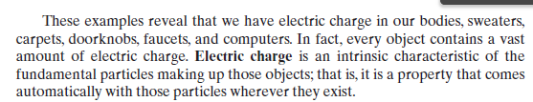

Slide 10
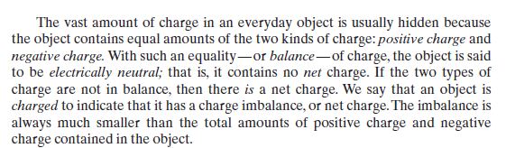

Slide 11
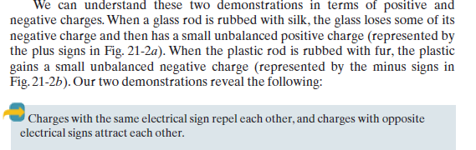

Slide 12
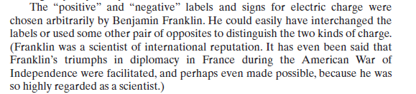

Slide 13
Methods of Charging Objects: Friction, Contact, and Induction
Normally atoms are in the lowest energy state. This means that the material is electrically neutral. You have the same number of electrons as protons in the material.
How do we change this?
How do we add more electrons than protons or remove electrons?

Slide 14
Summary Comments
Silk(+) on teflon(-)
Silk (-) on acrylic (+)
Wood doesn’t charge
Charged objects always attract neutral objects
Show Triboelectric series
Not only chemical composition important, structure of surface is important - monolayer of molecules involved, quantum effect. (nanotechnology)

Slide 15
Triboelectric series http://www.sciencejoywagon.com/physicszone/lesson/07elecst/static/triboele.htm

Slide 16


Conductors and insulators
All materials contain electrons.
The electrons are what carry the current in a conductor.
The electrons in insulators are not free to move—they are tightly bound inside atoms.

Slide 17
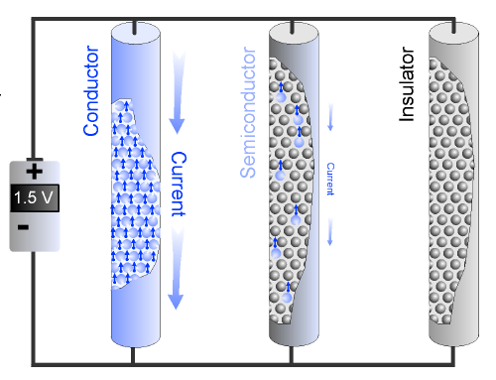
Conductors and insulators
A semiconductor has a few free electrons and atoms with bound electrons that act as insulators.

Slide 18
Conductors and insulators
When two neutral objects are rubbed together, charge is transferred from one to the other and the objects become oppositely charged.
This is called charging by friction.
Objects charged by this method will attract each other.
Notes:
A charged balloon will stick to a (neutral) wall or other insulating surface.
When a negatively charged balloon is near a wall, electrons inside atoms in the wall are repelled.
Since the wall is made of insulating material, the repelled electrons are not free to travel between atoms.
The electrons can move within each atom, so they spend more time on the side of the atom that is farthest from the balloon.

Slide 19
Conductors and Insulators
Conductors | Insulators
Electrons flow easily between atoms
1-3 valence electrons in outer orbit
Examples: Silver, Copper, Gold, Aluminum
Electron flow is difficult between atoms
5-8 valence electrons in outer orbit
Examples: Mica, Glass, Quartz

Slide 20
Summary: Electrostatics is based on 4 four empirical facts
Conservation of charge
Quantization of charge
Coulomb’s Law
The principle of superposition

Slide 21
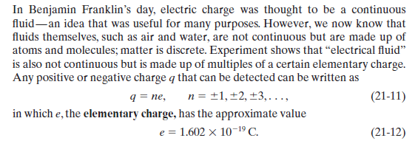
Quantization of charge

Slide 22
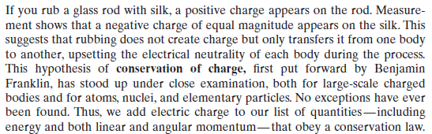
Conservation of charge

Slide 23

Examples of Conservation of Charge

Slide 24
Conservation of charge
Rubbing does not create charge, it is transferred from one object to another
Teflon negative - silk positive
Acrylic positive - silk negative
Nuclear reactions γ⁰ = e⁺ + e⁻
Radioactive decay ²³⁸U₉₂ = ²³⁴Th₉₀ + ⁴He₂
High energy particle reactions e⁻ + p⁺ = e⁻ + π⁺ + n⁰

Slide 25
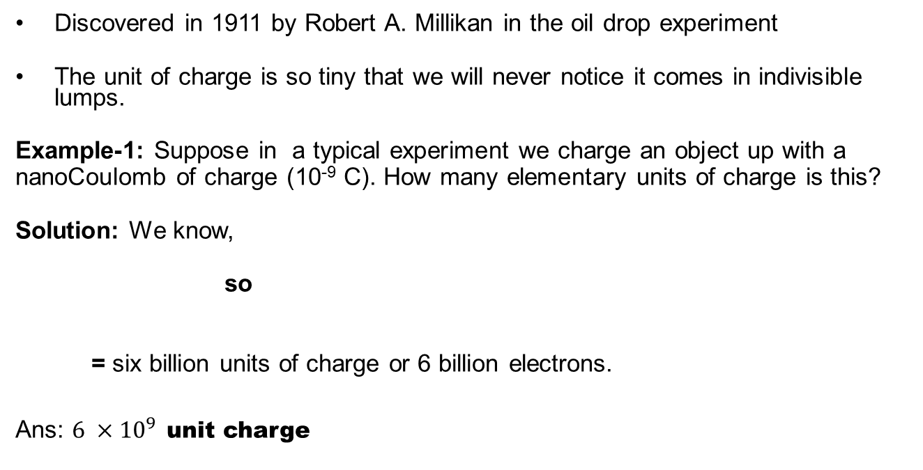
What is meant by quantization of charge?
Discovered in 1911 by Robert A. Millikan in the oil drop experiment
The unit of charge is so tiny that we will never notice it comes in indivisible lumps.
Example-1: Suppose in a typical experiment we charge an object up with a
nanoCoulomb of charge (10⁻⁹ C). How many elementary units of charge is this?
Solution: We know,
so
= six billion units of charge or 6 billion electrons.
Ans: $6 ×{10}^{9}$ unit charge

Slide 26
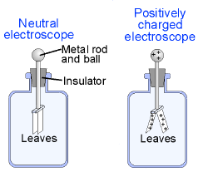
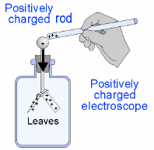
Electric forces
The forces between the two kinds of charge can be observed with an electroscope.
Notes:
An electroscope contains two very thin leaves of metal that can swing from a central rod connected to a metal ball. Charges can flow freely between the ball and the leaves.
Suppose a positively charged rod touches the metal ball of an electroscope.
Some negative electrons are attracted to the rod.
The metal ball and leaves of the electroscope are left with a net positive charge.
Since both leaves have the same positive charge, the leaves repel each other and spread apart.
Once an electroscope is charged, it can be used to test other charged objects.
The leaves spread farther apart if another positively charged rod is brought near the metal ball.
This happens because the positive rod attracts some negative electrons from the leaves toward the ball, increasing the positive charge on the leaves.

Slide 27
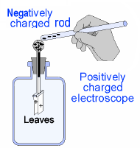
Electric forces
Charge can be transferred by conduction.
Notes:
If a negatively charged rod touches the ball, the opposite effect occurs.
A negatively charged rod repels negative electrons from the ball into the leaves
where they neutralize some of the positive charge. The positive charge on the
leaves is reduced and the leaves reduce their repulsion.

Slide 28
Electric current
Current is the movement of electric charge through a substance.
Charge that flows
(coulombs)
Current
(amps)
I = q
t
Time (sec)

Slide 29
Calculate current
Two coulombs of charge pass through a wire in five seconds.
Calculate the current in the wire.
Notes:
1) You are asked to find the current.
2) You are given the charge and the time.
3) Use the equation I = q/t.
4) Solve: I = (2 C) ÷ (5 sec) = 0.4 C/sec or 0.4 A

Slide 30
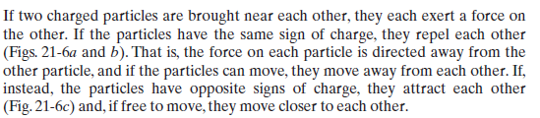
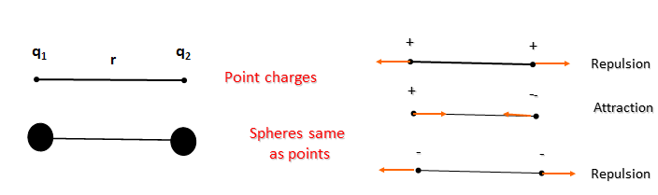
Coulombs Law

Slide 31
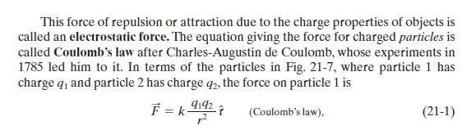
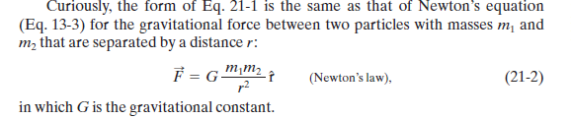

Slide 32
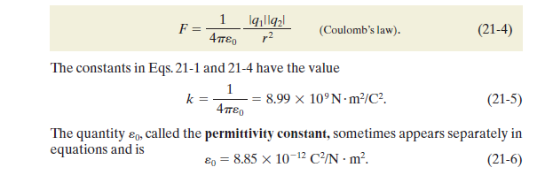

Slide 33
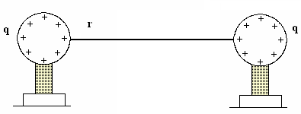
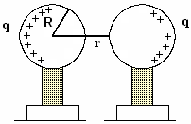
Uniformly charged metal spheres of Radius R
Demo: Show uniformity of charge around sphere using
electrometer.
Demo: Show charging spheres by induction using
electrometer

Slide 34
Coulombs Law Two Positive Charges
Example-2: What is the force between two positive charges each 1 nano Coulomb, 1cm apart in a typical demo? Why is the force so weak here?
Solution:
q₁
r
q₂
1 nC
1 cm
1 nC
Repulsion
(equivalent to a weight of something with a mass of 10⁻⁵ kg = 10⁻² gm or 10 mg - long strand of hair)

Slide 35
Coulombs Law Two Pennies without electrons
Example-3: (i) What is the force between two 3 gm pennies one meter apart if we remove
all the electrons from the copper atoms? [Modeling] (ii) What is their acceleration as they
separate?
Solution: (i) We know,
The force is
The atom Cu has 29 protons and a 3 gm penny has
=
The total charge is
(ii) What is their acceleration as they separate?

Slide 36
Principle of Superposition Three charges In a line
In the previous example we tacitly assumed that the forces between nuclei simply added and did not interfere with each other. That is the force between two nuclei in each penny is the same as if all the others were not there. This idea is correct and is referred to as the Principle of Superposition.
Example-4: Example of charges in a line.
Three charges lie on the x axis: q₁=+25 nC at the origin, q₂= -12 nC at x =2m, q₃=+18 nC at x=3 m. What is the net force on q₁?
Solution: We simply add the two forces keeping track of their directions. Let a positive force be one in the + x direction.
^{x}
¹
²
³

Slide 37
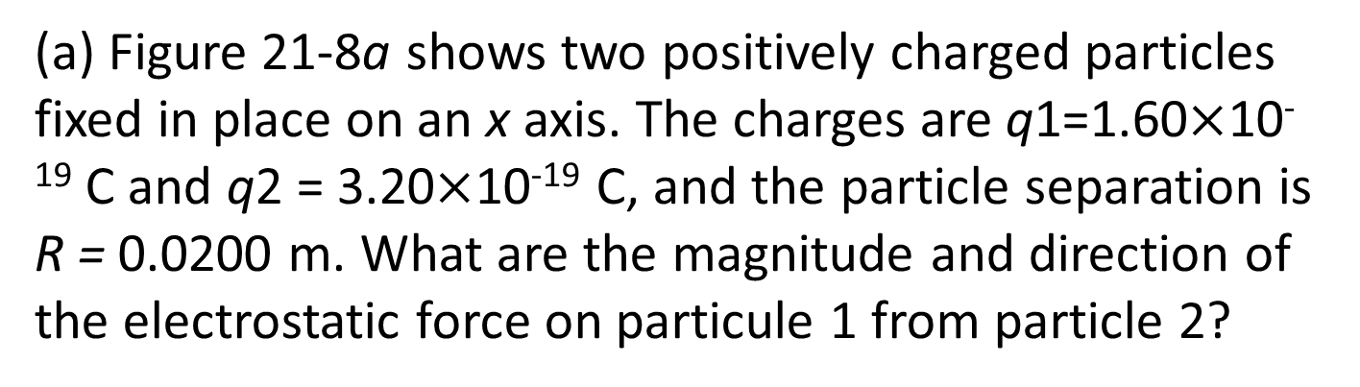
Finding the net force due to two other particles
(a) Figure 21-8a shows two positively charged particles fixed in place on an x axis. The charges are q1=1.60$×$10⁻¹⁹ C and q2 = 3.20$×$10⁻¹⁹ C, and the particle separation is R = 0.0200 m. What are the magnitude and direction of the electrostatic force on particule 1 from particle 2?

Slide 38
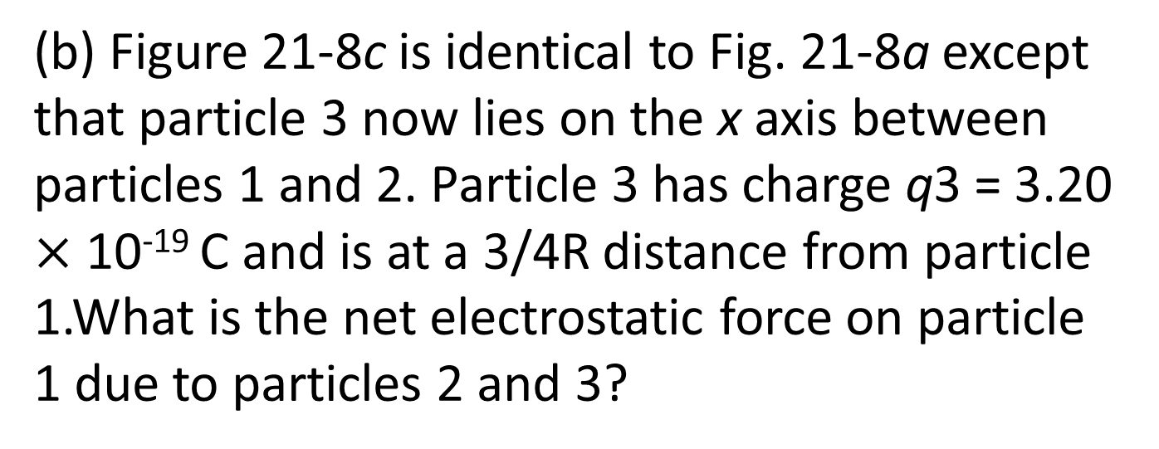
(b) Figure 21-8c is identical to Fig. 21-8a except that particle 3 now lies on the x axis between particles 1 and 2. Particle 3 has charge q3 = 3.20 $×$ 10⁻¹⁹ C and is at a 3/4R distance from particle 1.What is the net electrostatic force on particle 1 due to particles 2 and 3?

Slide 39
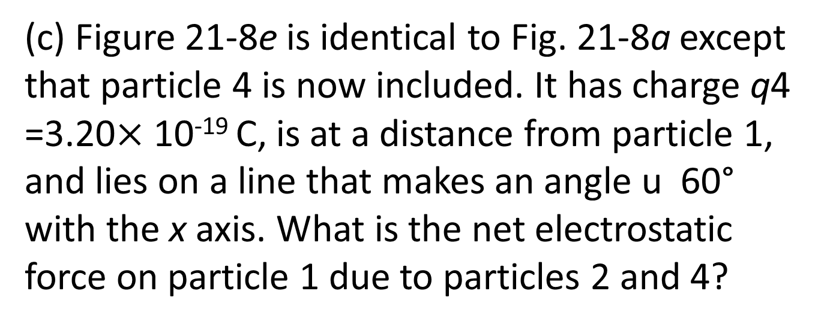
(c) Figure 21-8e is identical to Fig. 21-8a except that particle 4 is now included. It has charge q4 =3.20$×$ 10⁻¹⁹ C, is at a distance from particle 1, and lies on a line that makes an angle u 60° with the x axis. What is the net electrostatic force on particle 1 due to particles 2 and 4?

Slide 40
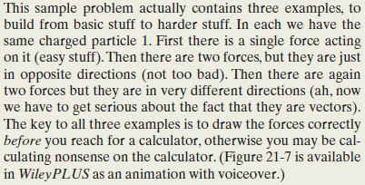

Slide 41
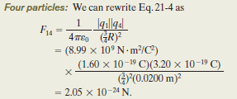
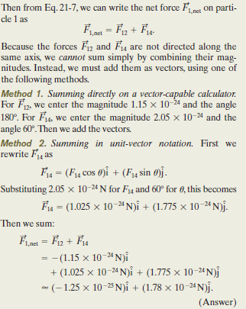

Slide 42
Example-5: Three point charge
q₃= - 2 nC
+y
2 cm
F_{net}
F₁₃
F₁₂
1 cm
+x
q₁= + 1 nC
q₂= + 1 nC
Question: What is the net force on q₁ and in what direction?
Hint : Find x and y components of force on q₁ due to q₂ and q₃ and add them up.

Slide 43
Solution:
q₃= - 2 nC
x and y Components of force due to q₂
+y
2 cm
x and y Components of force due to q₃
F₁₃
Magnitude of Force due to q₃
θ
F₁₂
1 cm
+x
q₁= + 1 nC
q₂= + 1 nC
F₁₃
F_{13y}
θ
F_{13x}

Slide 44
Example Cont.
Total force along the x-axis
q₃= - 2 nC
+y
Total force along the y-axis
F_{net}
F₁₃
θ₁
θ
1 cm
+x
F₁₂
q₁= + 1 nC
q₂= + 1 nC

Slide 45
Example-6: In an atom can we neglect the gravitational force between the electrons and protons? What is the ratio of Coulomb’s electric force to Newton’s gravity force for 2 electrons separated by a distance r ?
Solution:
q
r
q
m
r
m
Huge number, pure ratio

